Slide 1
DILAPAN-S
Powerpoint product template_Jan2023

Slide 2
Headline
Text 1
Text 2

Slide 3
Charts

Slide 4
Tables

Slide 5
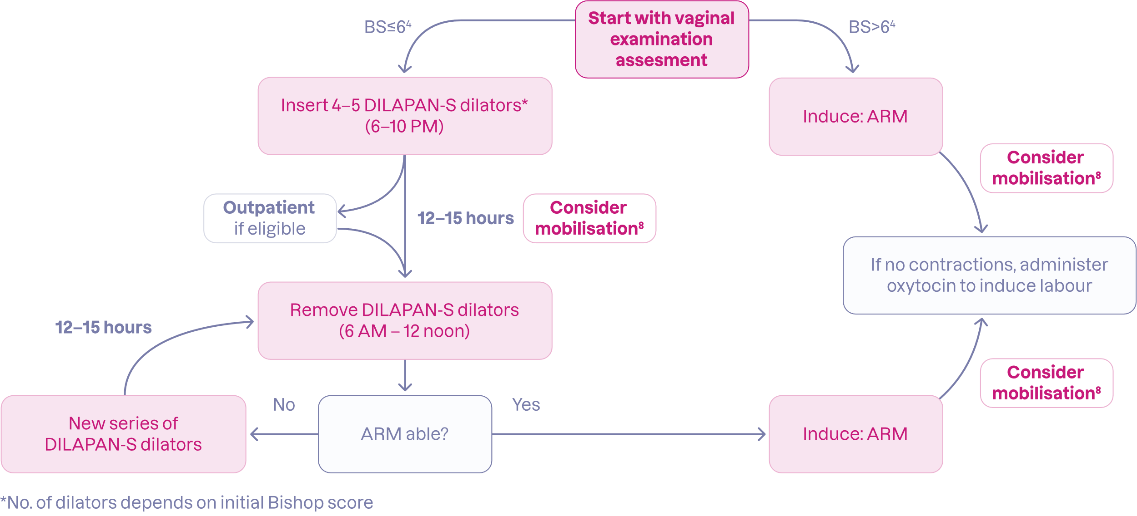
Example of DILAPAN-S IOL clinical protocol

Slide 6
Logo, lotos symbol
White logo is intended to be used without the pink background.

Slide 7
Illustrations - white

Slide 8
Illustrations - purple

Slide 9
Pictograms - white

Slide 10
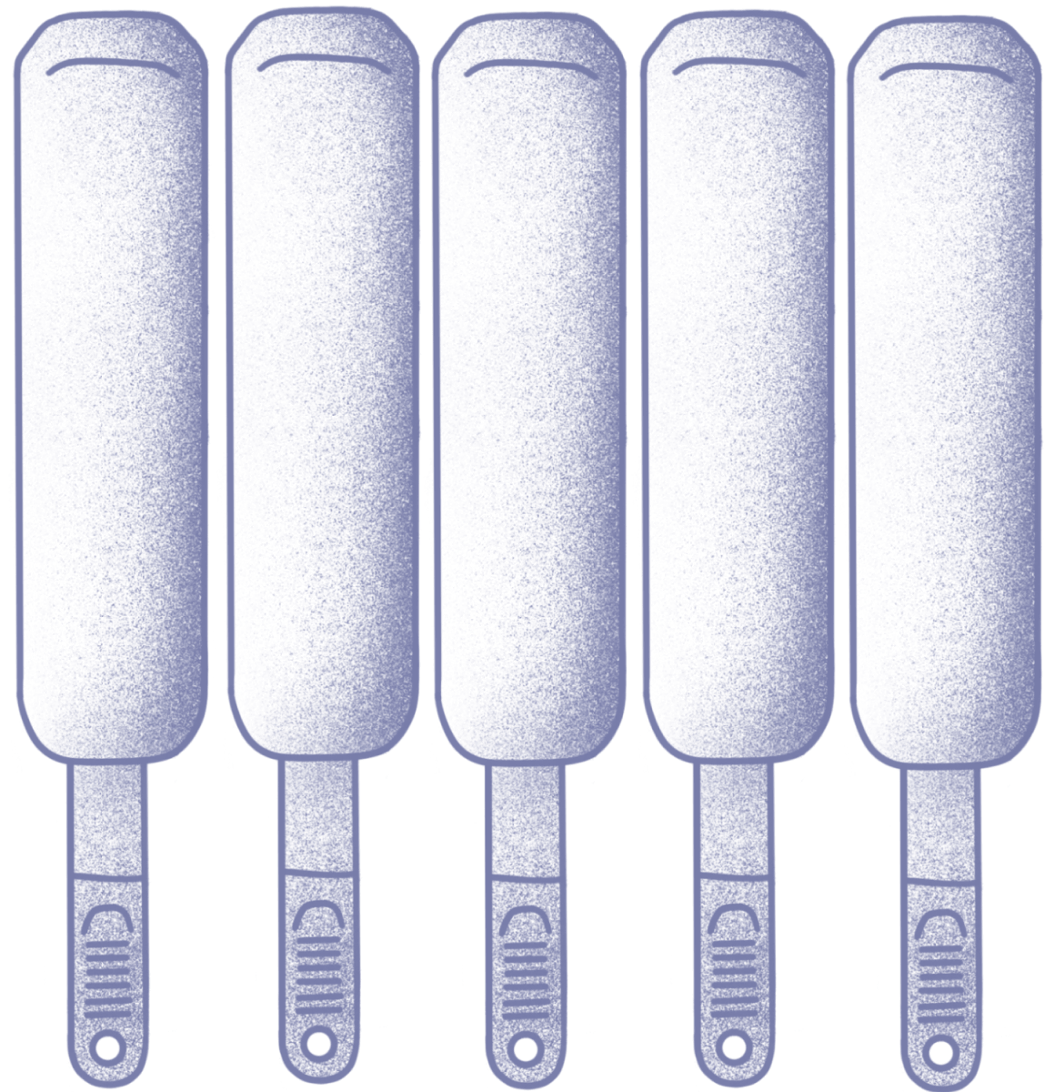
Pictograms - purple

Slide 11
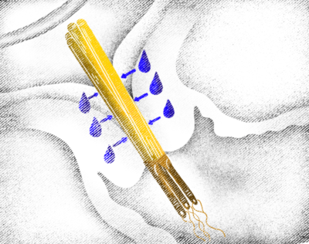
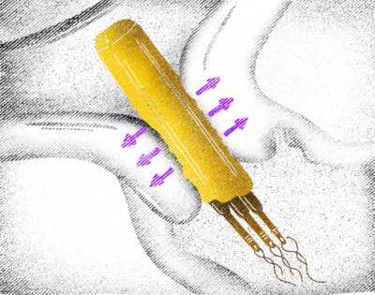
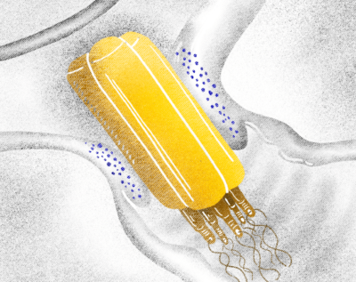
Mode of action animation

Slide 12
Choose a new slide, with or without logo
New slide without logo
New slide with logo

Slide 13
Use preset theme colours
Feel free to use the first seven preset colours according the brand manual

Slide 14
Use preset table styles
Kindly choose preset table styles

